Slide 1
HTML
HTML stands for Hyper Text Markup Language.
It is the main markup language for describing the structure of web pages.
Hypertext:- machine readable text.
Markup:- a computer language that consists of easily understood keywords, names or tags that help to format the overall view of a page and the data it contains.
Hypertext markup language (HTML):- is the set of markup symbols or codes inserted into a file intended for display on the internet.

Slide 2
HTML consists a series of elements.
Apart from text, hyper text may contain tables, lists, forms, images and other presentational elements. It is an easy to use and flexible format to share information over the internet.
Markup languages use sets of markup tags to characterize text elements within a document, which gives instructions to the web browser on how the document should appear.
HTML was originally developed by Tim Berners-Lee in 1990 G.C. He is also known as the father of the web.
HTML 5 is the latest version of HTML.

Slide 3
Visualization of HTML page structure
<html>
<head>
<title> Page title
<title>
</head>
<body>
<h1> This is heading </h1>
<p> This is paraghraph </p>
</body>
</html>

Slide 4
A simple HTML document
<!DOCTYPE html>
<html>
<head>
<title>Page title</title>
</head>
<body>
<h1>My first heading</h1>
</body>
</html>

Slide 5
The <!DOCTYPE html> declaration defines that this document is an HTML 5 document.
The <html> element is the root element of an HTML page.
The <head> element contains meta information about the HTML page.
The <title> element specifies a title for the HTML page (which is shown in the browsers title bar or in the page’s tab).
The <body> element defines the document’s body, and is a container for all the visible contents, such as headings, paragraphs, images, hyper links, tables, lists etc.
The <h1> defines a larger heading.
The <p> defines a paragraph.

Slide 6
What is an HTML element
An HTML element is defined by a start tag, some content and an end tag.
<tag name> Some contents here…</tag name>
The html element is everything from the start tag to the end tag.
Some HTML elements have no content (like the <br> element). This elements are called empty elements. Empty elements do not have an end tag.

Slide 7
What you can do with HTML?
You can publish documents online with text, images, lists, tables etc.
You can access web resources such as images, videos or other HTML documents via hyper links.
You can create forms to collect user inputs like name, e-mail address, comments etc.
You can include images, videos, sound clips, flash movies, applications and other HTML documents directly inside an HTML document.
You can create offline version of your website that work without internet.
You can find the current location of your website visitor.
The list does not end here, there are many other interesting things that you can do with HTML . You will learn about all of them in detail in upcoming tutorials.

Slide 8
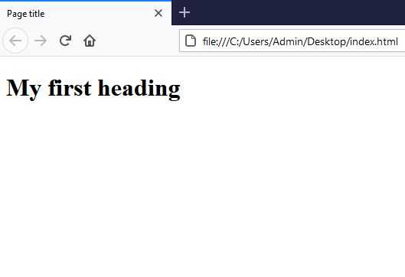
Web browsers
The purpose of a web browser (Chrome, Edge, Firefox, Safari) is to read HTML documents and display them correctly.
A browser does not display the HTML tags, but uses them to determine how to display the document.
<!DOCTYPE html>
<html>
<head>
<title>Page title</title>
</head>
<body>
<h1>My first webpage</h1>
</body>
</html>

